Slide 1
WEB ENGINEERING “JAAGO”

Slide 2

GROUP MEMBERS Mahad Masood Bajwa Muhammad Uzair Muneeb Shahryar

Slide 3
Objectives
Platform for people to discuss about mental Health problems.
Create awareness about mental health
Help the people who might be facing such issues in their life.
Provides a very positive way of addressing such issues unlike any other source.
One of its kind and provides videos and blogs as the main source to create awareness.

Slide 4
450 million
People suffer from some sort of Mental issue. Whoa! That’s a big number, Gotta do something about it!

Slide 5
Why awareness is needed
Great number of people commit suicide because there is no proper channel to handle such issue.
Countries like Pakistan lack even basic facilities to curb such issues.
It can not be handled in a small time, people need a lot of time to get over their inner mental issues.
Culture barriers hinder people from getting help so using internet for this can be best solution out there.

Slide 6
They are not crazy , they do need help.

Slide 7
Highlights of the Project

Slide 8


Web Technologies :
HTML
CSS
BOOTSTRAP
JAVASCRIPT
JQUERY
MONGODB
MONGOOSE
NODEJS

Slide 9
Features:
HTML
CSS
BOOTSTRAP
JAVASCRIPT
JQUERY
MONGODB
MONGOOSE
NODEJS

Slide 10
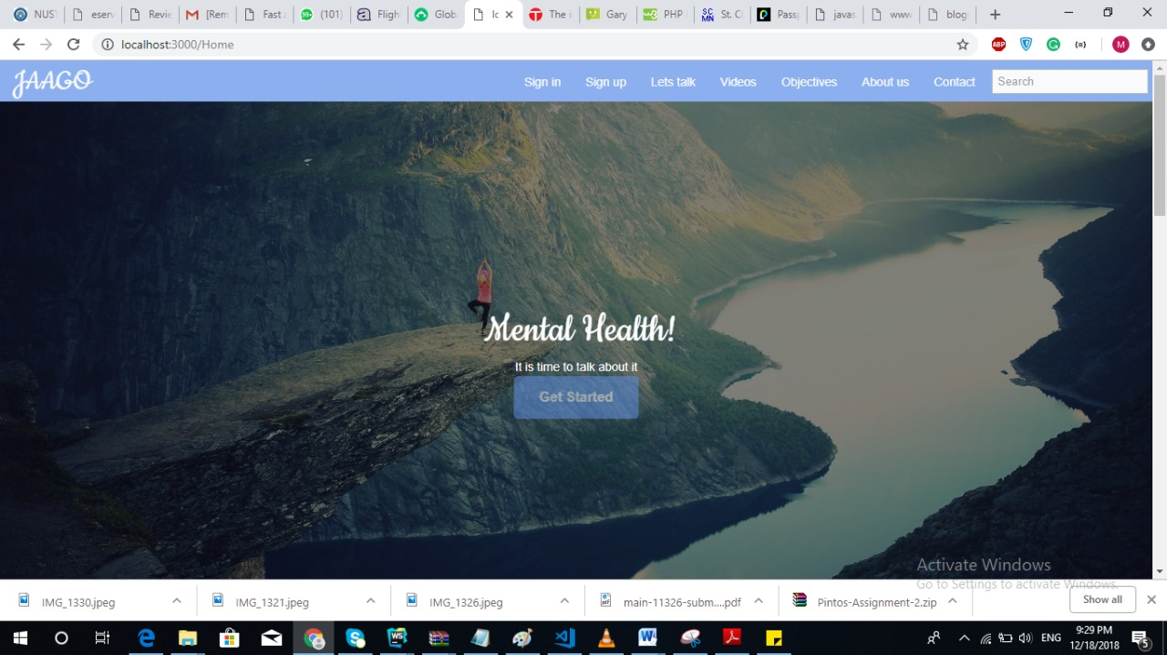
Homepage

Slide 11
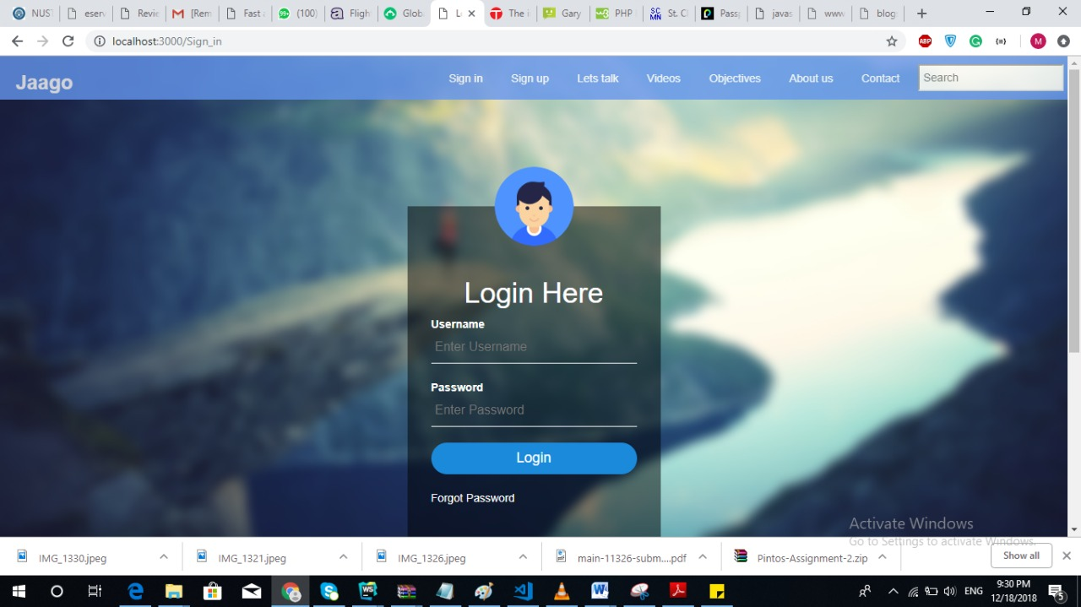
User Login

Slide 12
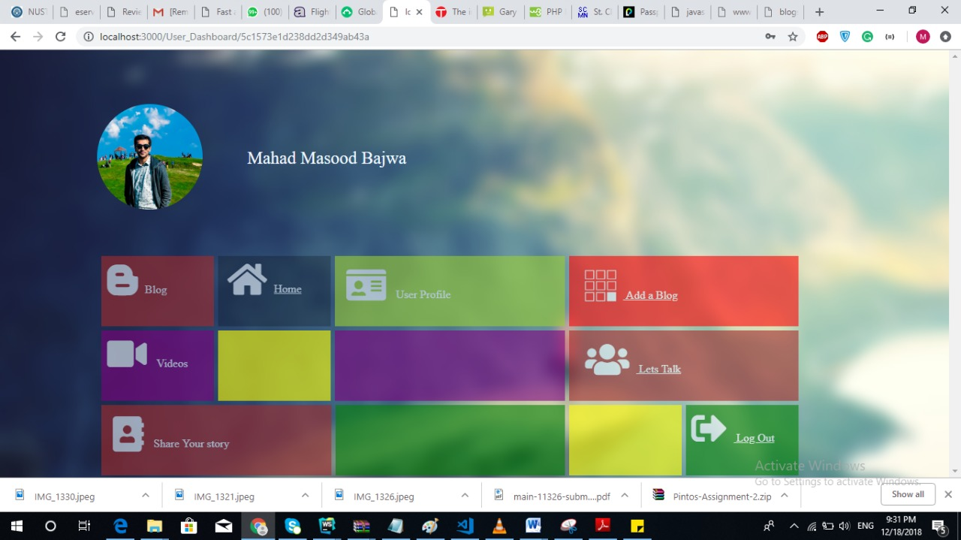
User Dashboard

Slide 13
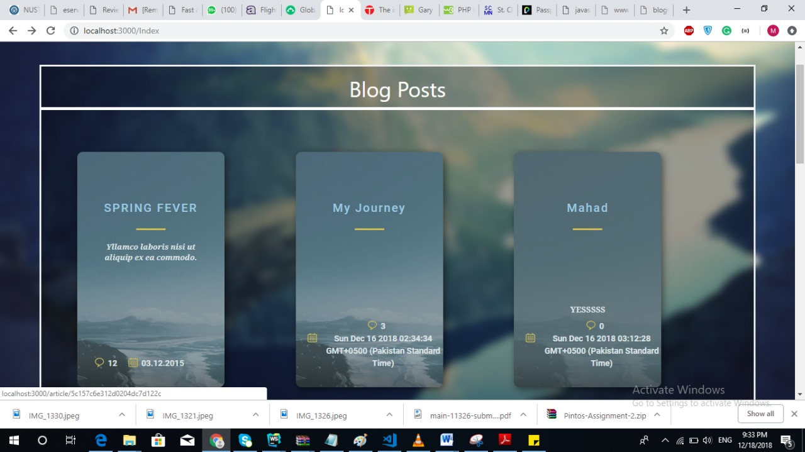
BlogPosts

Slide 14
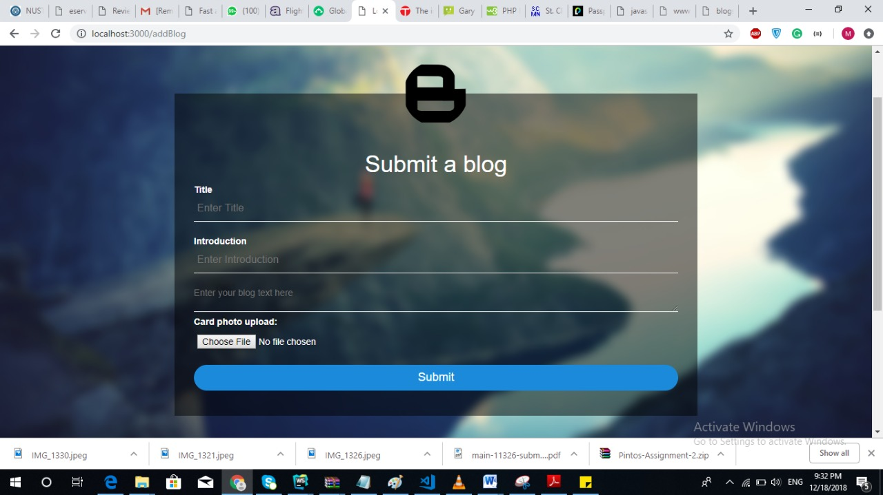
Submission Of blog

Slide 15
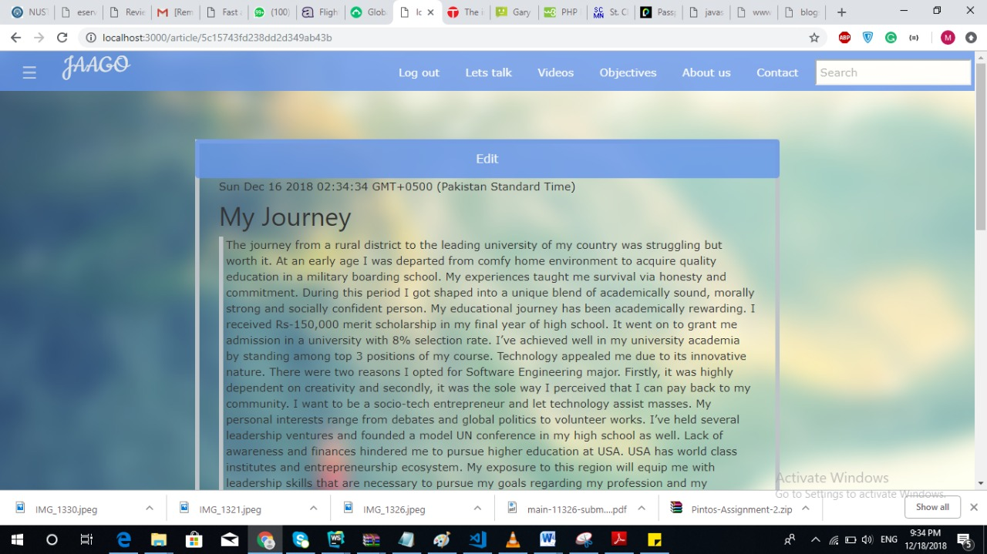
Main Blog Page

Slide 16
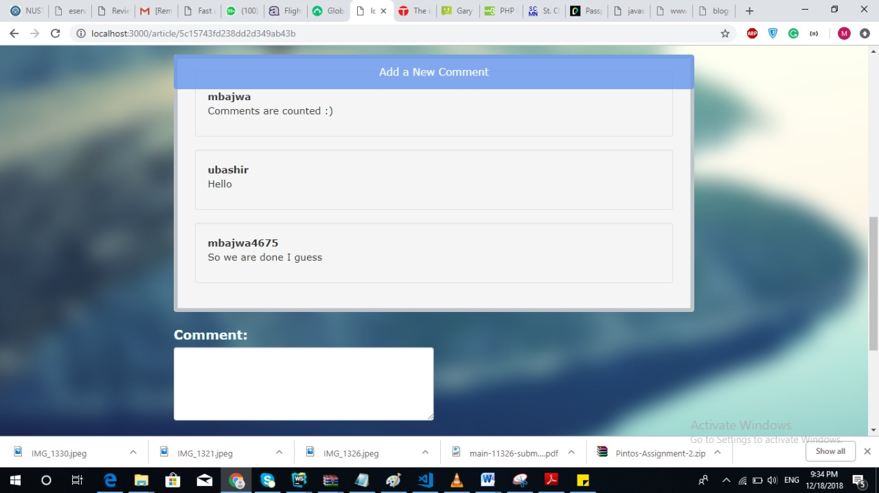
Comment Section

Slide 17
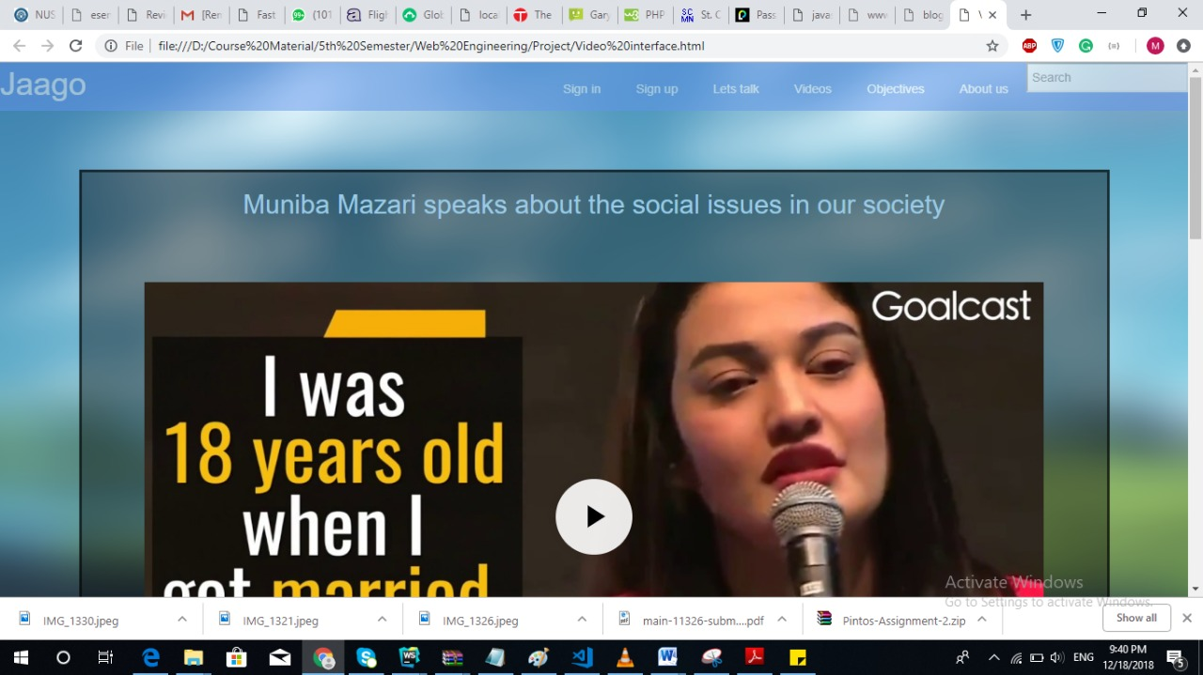
Video interface

Slide 18
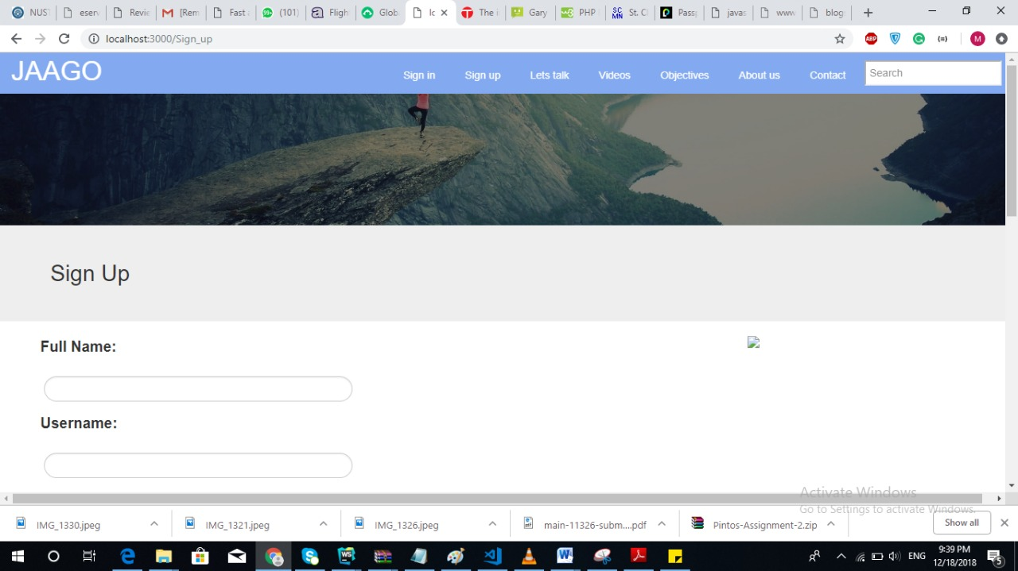
Sign up

Slide 19
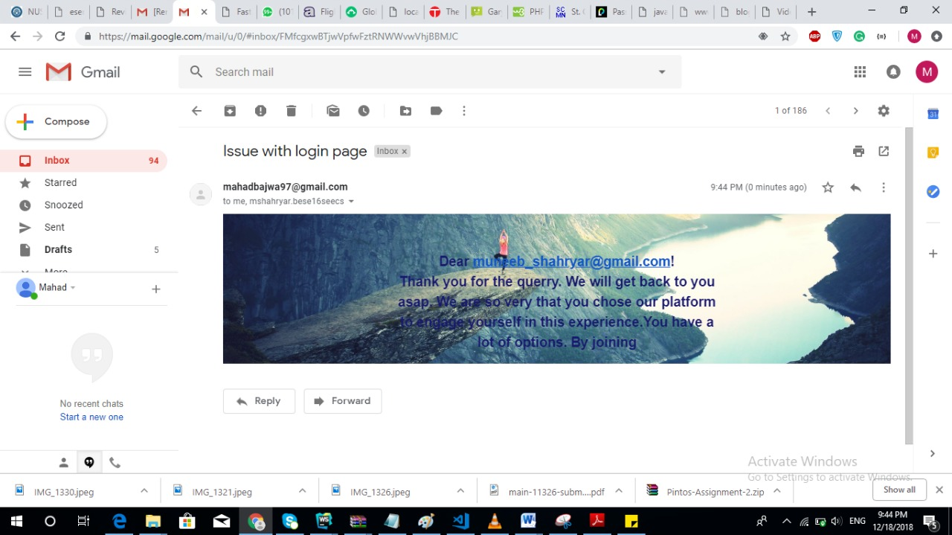
Automated Email after sign up

Slide 20
Problems Faced:
Image upload issue : solved by MULTER NodeJS component
Authentication errors : solved by NodeJS passport component
Manipulating webpage with respect to login.

Slide 21
Distribution of the work
Mahad :
Login sessions
Webpage Manipulation wrt to login Display
User Dashboard
Comment section
Notifications on blog comments
Uzair:
Email functionality
Video hosting functionality and video display interface
User profile
Contact us
Muneeb:
Make a blog
Edit a blog
Database model

Slide 22
Q&A

Slide 23
Thank You

